Slide 1
RETAIL STORE TRANSACTIONS
AKILA S
DATA ANALYSIS SEP 2025 BATCH

Slide 2
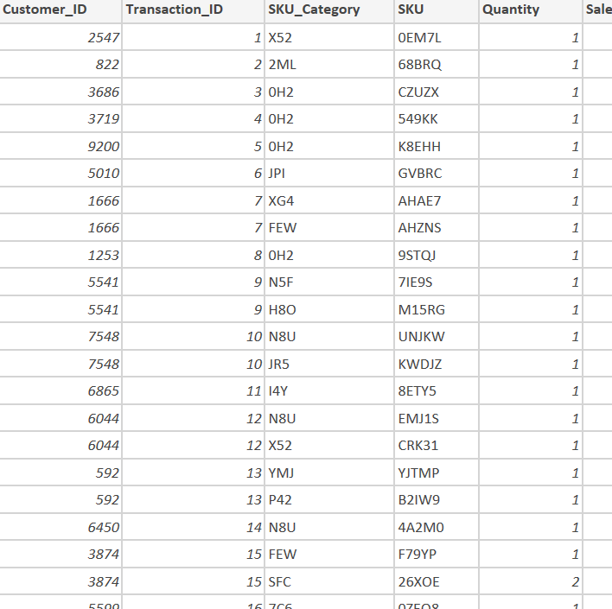
KEY TOPICS
DATA TRANSFORMATION (POWER QUERY)
DAX MEASURES
DASHBOARD DESIGN
KEY BUSINESS INSIGHTS
CONCLUSION & FUTURE SCOPE

Slide 3
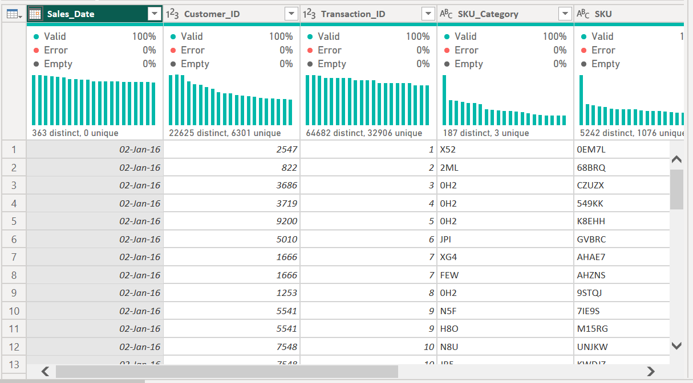
DATA TRANSFORMATION
MISSING VALUES (NULL)
HEADER RENAME
SALES CATEGORIZATION
CONDITIONAL COLUMN
INCONSISTENT RECORDS (NULL)

Slide 4
DAX MEASURES
Total Sales =
SUM ( Sheet1[Sales_Amou nt] )
Avg Purchase Frequency =
DIVIDE (
[Total Transactions],
[Total Customers]
)
Total Customers =
DISTINCTCOUNT ( Sheet1[Customer_ID] )
Average Order Value =
DIVIDE ( [Total Sales], [Total Transactions] )
Total Transactions =
DISTINCTCOUNT ( Sheet1[Transaction ID] )
Sales per Customer =
DIVIDE ( [Total Sales], [Total Customers] )

Slide 5
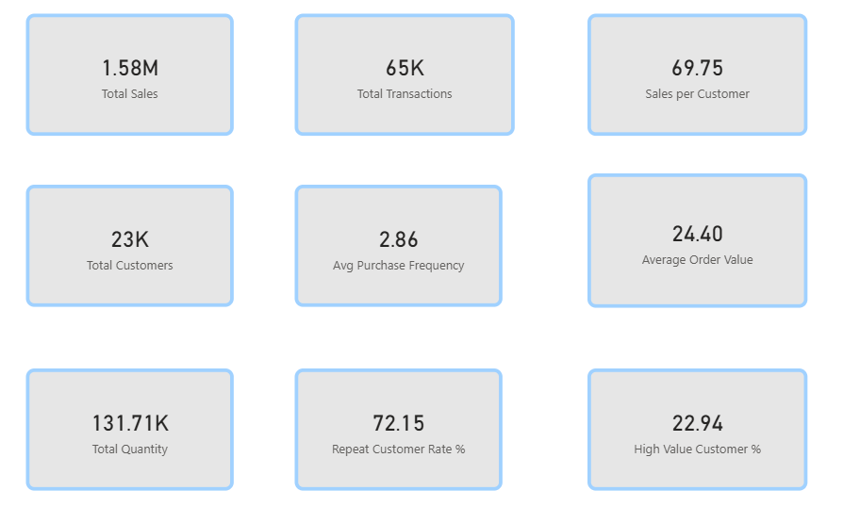
DAX FUNCTION VALUES

Slide 6
DASHBOARD
SALES TREND BY MONTH
SALES CONTRIBUTION BY CATEGORY
TOTAL QUANTITY VS TRANSACTION ID
SALES BY PRODUCT CATEGORY
CUSTOMER SALES VS AVERAGE ORDER VALUE BY MONTH
KPI VALUES

Slide 7
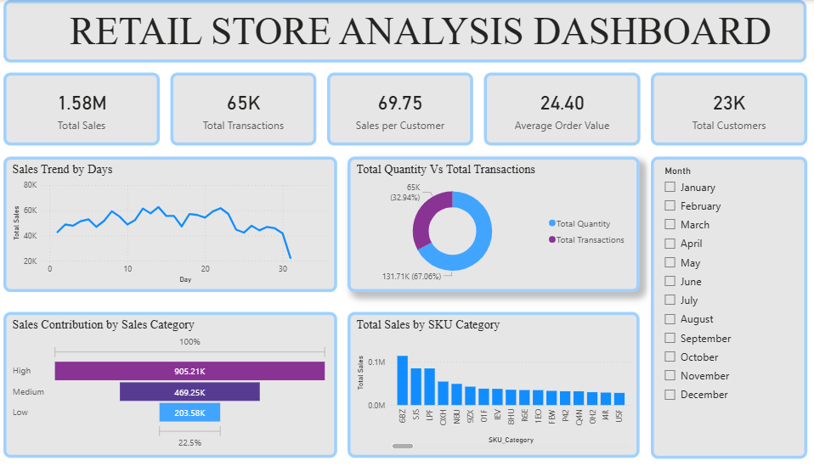

Slide 8
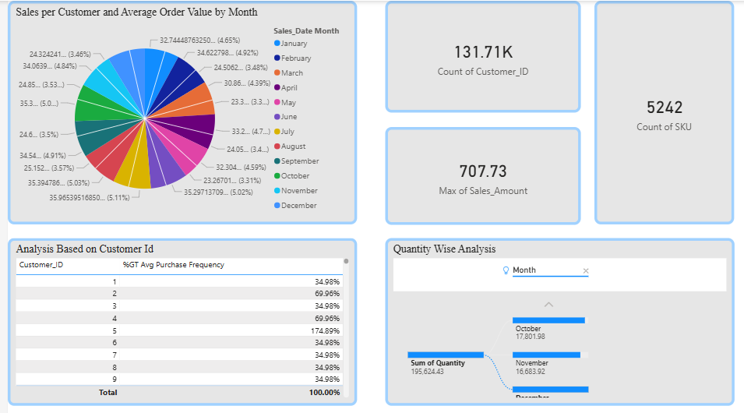

Slide 9
KEY BUSINESS INSIGHT
STRONG SEASONAL SALES PEAK
HIGH-PERFORMING SKU CATEGORIES
CUSTOMER SPEND PATTERNS
PRODUCT CATEGORY CONTRIBUTION
SALES TRENDS OVER TIME

Slide 10
ACTIONABLE RECOMENDATIONS
STOCK OPTIMIZATION FOR PEAK SEASONS
CUSTOMER LOYALTY FOCUS
PRIORITIZE HIGH-CONTRIBUTION CATEGORIES
FORECAST & PLAN FOR SEASONAL TRENDS
REDUCE UNDERPERFORMING SKUS

Slide 11
CONCLUSION
BY ANALYZING THIS INFORMATION, BUSINESSES CAN IDENTIFY THEIR MOST POPULAR ITEMS, UNDERSTAND CUSTOMER PURCHASING BEHAVIORS, AND DETECT SALES TRENDS OVER TIME.
THIS DATASET SERVES AS A VALUABLE RESOURCE FOR MAKING INFORMED DECISIONS ABOUT INVENTORY MANAGEMENT, MARKETING STRATEGIES, AND SALES OPTIMIZATION.
OVERALL, IT REFLECTS AN ACTIVE RETAIL ENVIRONMENT WITH SIGNIFICANT OPPORTUNITIES FOR DATA-DRIVEN INSIGHTS TO ENHANCE OPERATIONAL EFFICIENCY AND PROFITABILITY.

